Slide 1

The Problem
Marketers are swimming in data
The data comes from multiple sources that change rapidly.
Many marketers are still manually gathering the data

Slide 2
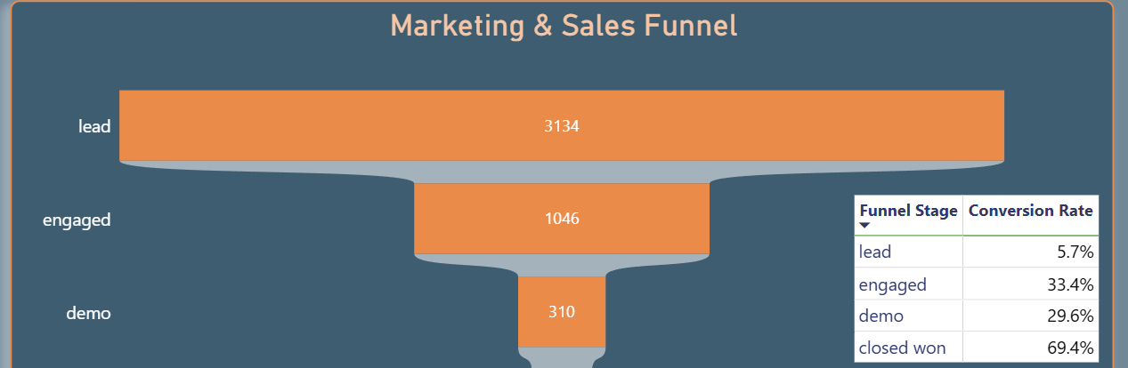
The Solution
To have a functioning, Live Dashboard that pulls in all data that marketers can use to optimize campaigns.
The second is to have an executive dashboard that, at a glance, other stakeholders can see the successes attributable to marketing and sales.

Slide 3


Slide 4
Functionality
1. Python extracts HubSpot and GA4 data via API
3. Python cleans, joins, and organizes the data
4. Python creates Power BI-ready files
5. Power BI reads those files
6. DAX handles dashboard-specific calculations

